Slide 1
Meet the teacher
orange Class
2026-2027

Slide 2
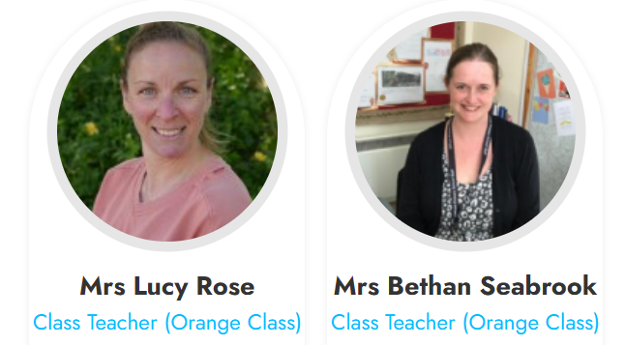
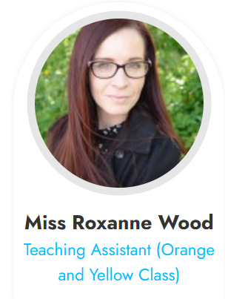
The class team
Teacher: Mrs Rose and Mrs Seabrook
Teaching Assistant: Miss Wood
{Insert picture}
{Insert picture}
Welcome to Year 5! We are excited to get started.

Slide 3

How to communicate with us
You are welcome to talk to us at any time.
If you’d like to talk to us at length regarding anything, please book an appointment through the office or contact us via class dojo.
Please contact the office via email or phone if a different adult is picking up your child. We will not release children unless we know in advance who they are meant to be going home with.

Slide 4
Ways the school will communicate with you
Please can we take the opportunity to remind you that the school will officially share information with you about upcoming activities and events in the following ways:
* Via the school calendar - this includes information about all currently planned activities between now and Christmas. The calendar can be located on the school website.
* Via the weekly newsletter. This is currently uploaded onto the school website and dojo. Upcoming dates, information about upcoming activities and celebrations of children's work are all included in this newsletter. The newsletter is sent out on a Friday afternoon.
* Via a direct email to your inbox. These will come through titled office@offham- please make sure that this address is not being filtered to your spam
* Via the class pages on the school website. Here you will find a termly newsletter detailing information about your child's learning and giving more specific information directly from the teacher about things the children may need this term.
* Via class dojo. Updates, upcoming trips, homework and general notices from your class teacher will appear here.

Slide 5
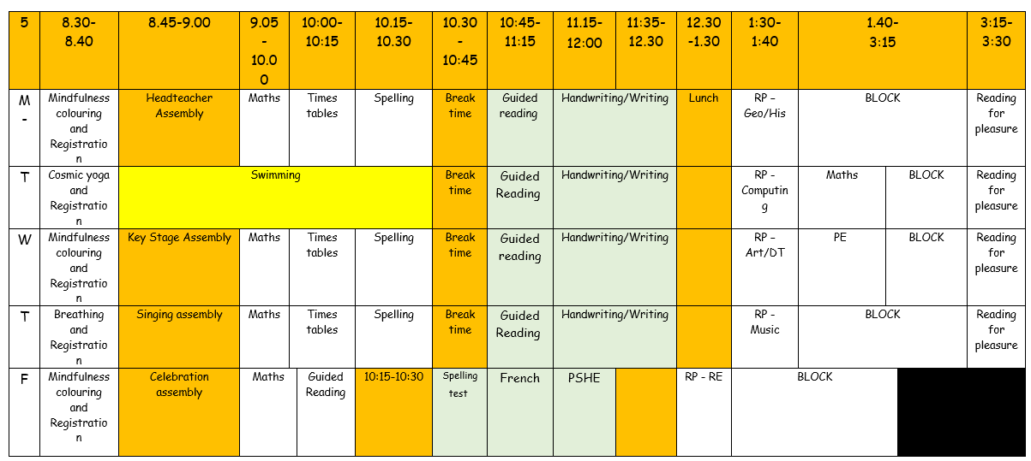
Class timetable

Slide 6

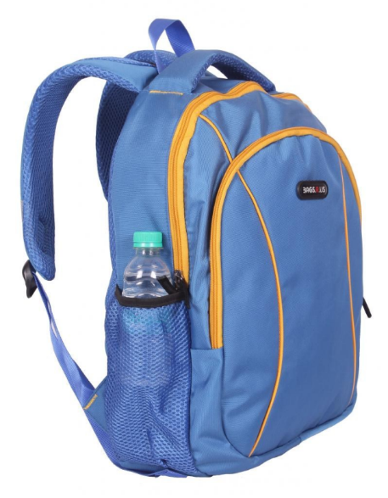


What does my child need in school?
Children should have a water bottle (named) in school every day.
School bags should be named and placed on pegs.
Children should not be bringing in pencil cases. Resources are ready to use in the classrooms each day.
Reading books from school (or home) should be brought in daily.

Slide 7

SCHOOL UNIFORM
Please can I remind you all that it is important that all children are dressed according to the school uniform policy.
Offham colours are red, white and grey. Children require:
red sweatshirts or cardigans (School logo or no logo)
grey trousers, shorts, skirts or pinafore dresses
checked red and white summer dresses
white polo shirts, shirts or blouses (School logo or no logo)
white or grey socks
grey tights
sensible black school shoes/boots - no open toes or heels
We ask that all hair, below chin length, is tied back sensibly with small hair bobbles and bows (this includes long hair on boys). Earrings should be small studs but should be removed for P.E. lessons. If this is not possible, please supply your child with medical tape to cover their earrings.

Slide 8
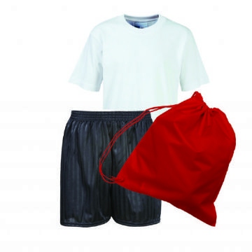
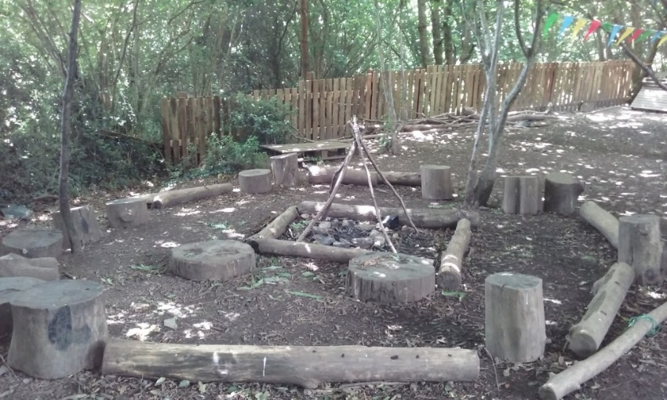
PE/FOREST SCHOOL UNIFORM
Children should wear PE kits on PE days as specified by the class teacher.
P.E t-shirt in the house colour (School logo or no logo)
Red hoodie (School logo or no logo)
P.E shorts black (to the knee)
Black leggings or black joggers
P.E socks – white
Outdoor black trainers
Children should wear PE kits on forest school days as specified by the class teacher.
Wellington boots for Forest School wet weather
Waterproof clothing for Forest School wet weather

Slide 9
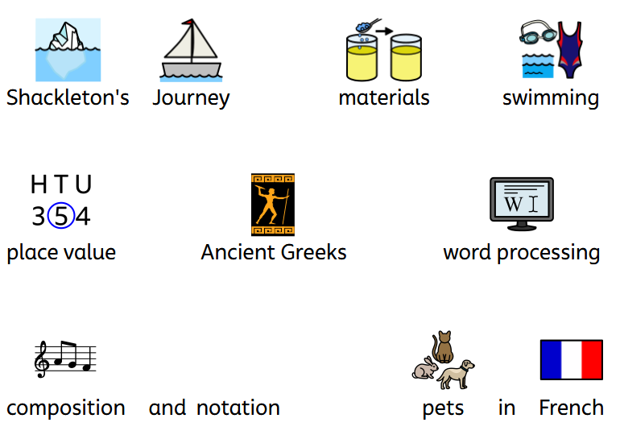
Examples of Topics for the year
For further information regarding this year's curriculum and a full overview, please see the school website.

Slide 10
Homework
Homework will be sent home each Friday.
A list of spellings or ‘sounds of the week’ will be sent home to practise. In KS2 they will have a written test the following Friday. There will also be an optional spelling sheet for KS2. This will be sent out on class dojo by your teachers, on Friday.
We will also expect the children to log onto Numbots and/or TT Rockstars to complete Maths fluency practise.
Daily reading is also a very important part of your child’s learning journey. This can be reading their school reading book and/or enjoying a reading for pleasure book of their choice.

Slide 11

Expectations with reading AND LEXIA
In KS2 reading is as important as it was in KS1. Please read with your child everyday (where possible), this could include comics, magazines, recipe instructions as well as their own story books. Reading to your child is just as beneficial as them reading to you.
In class, we will be reading with the children during guided reading lessons and via our new online platform ‘Lexia’. Children will be using this platform three times a week in school and also have a login to access at home.

Slide 12
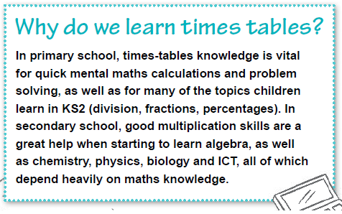
Times tables
KS2 is a crucial period for times tables learning.
We have times table lessons daily as well as covering them in maths lessons. We encourage you to still use TTRS as much as possible as times tables underpin lots of areas of maths, science and computing.
Some techniques you can use to help children learn their times tables at home include:
Practising them by rote (old-fashioned chanting)
Asking them questions out of order – such as ‘What is 11X12?
Asking your child related division facts
Using arrays to help them memorise – you can use fun objects like smarties or Lego bricks
Use apps and games to help build speed
Singing!!

Slide 13



Strategies and rewards
Golden balls
House points
Dojos
Certificate of Achievement
Celebration of work with Headteacher

Slide 14

Friday celebration assembly
Friday celebration assemblies will still be held on a Friday morning but this year – you’re invited!
If your child has received a certificate, you will be notified a week prior and have the opportunity to come in and see your child obtain their certificate in assembly!

Slide 15
Dates for parents evening
Tuesday 20th October – 3.45 – 6.30 pm
Thursday 22nd October – 3.45 – 6.30 pm

Slide 16
What’s coming up?
Village walk day – 16th October
Discovery Den opening/Party in the Park – 18th September
Open mornings for current parents – 29th September and 1st October 9.30 am, 11.00 am and 2.00 pm.
School Disco – 1st October
Inset day – 23rd October

